Slide 1
(Simple)
Artist Recommander with KNN
Spotify Artist Dataset
By Frédéric Zalma

Slide 2
Project Definition
Dataset Details
27620 artists
Various metrics : 'acousticness', 'danceability', 'duration_ms', 'energy’, 'instrumentalness', 'liveness', 'loudness', 'speechiness', 'tempo’, 'valence', 'popularity', 'key', 'mode',
Genre list per artist (2664 different genres)
4 researchs :
Estimate ‘Popularity’ via Regression
Artist Recommander with metrics data via KNN
Artist Recommander with genre via KNN
Unsupervised Nearest Neighbor

Slide 3
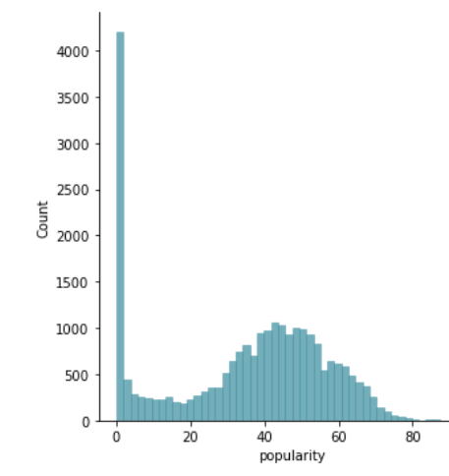
Estimate Popularity via Regression
‘Popularity’ Metrics was put at 0 for many songs.
Above > 15, it followed a Normal dispersion.
All artists will popularity below 5 will be our Test sample.

Slide 4
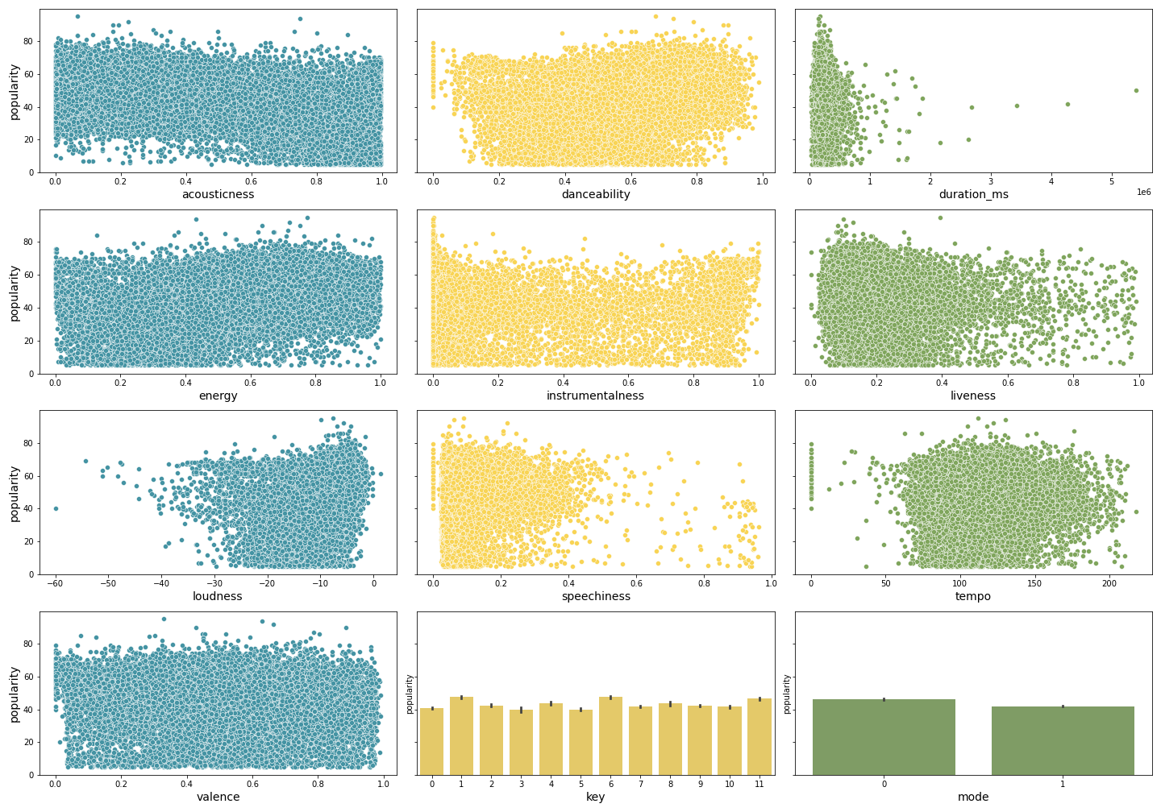
No specific correlation of the metrics with popularity data

Slide 5
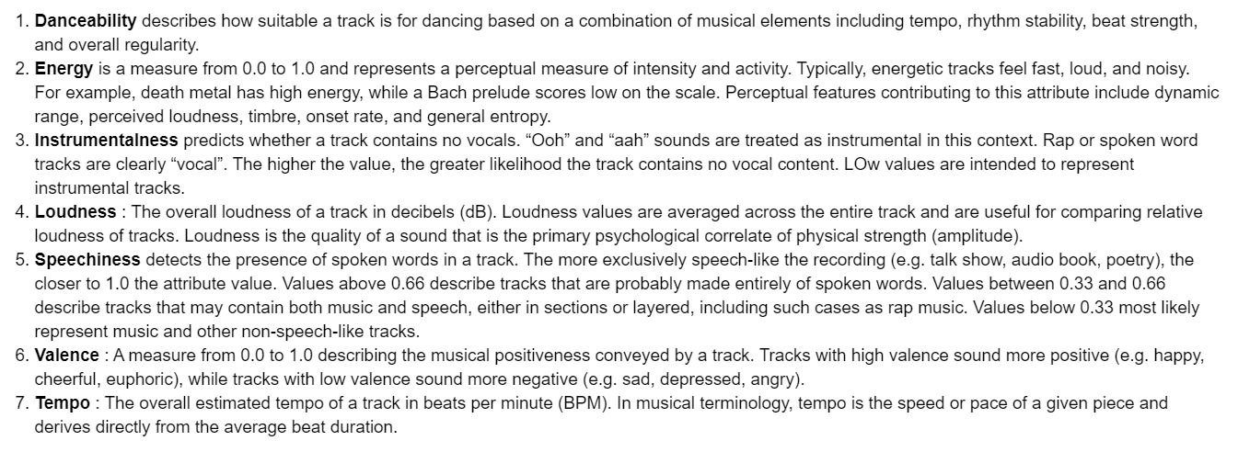

Slide 6
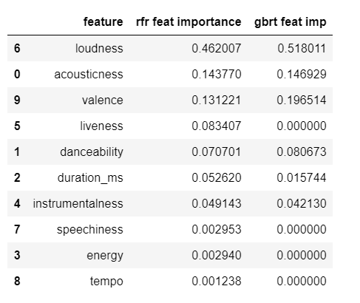
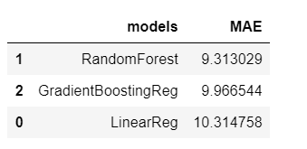
Regression Models
The overall loudness of a track in decibels (dB). Loudness values are averaged across the entire track and are useful for comparing relative loudness of tracks. Loudness is the quality of a sound that is the primary psychological correlate of physical strength (amplitude).

Slide 7
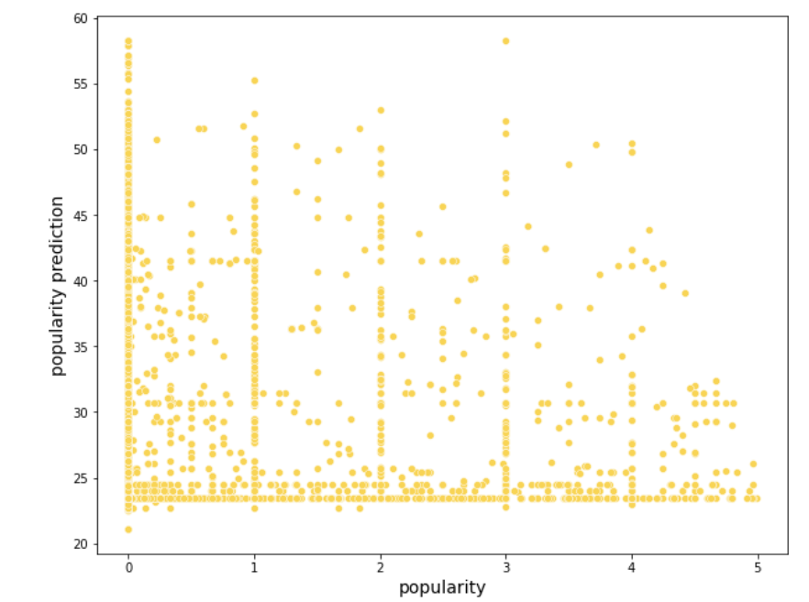

Popularity recalculation for artist with pop below 5

Slide 8
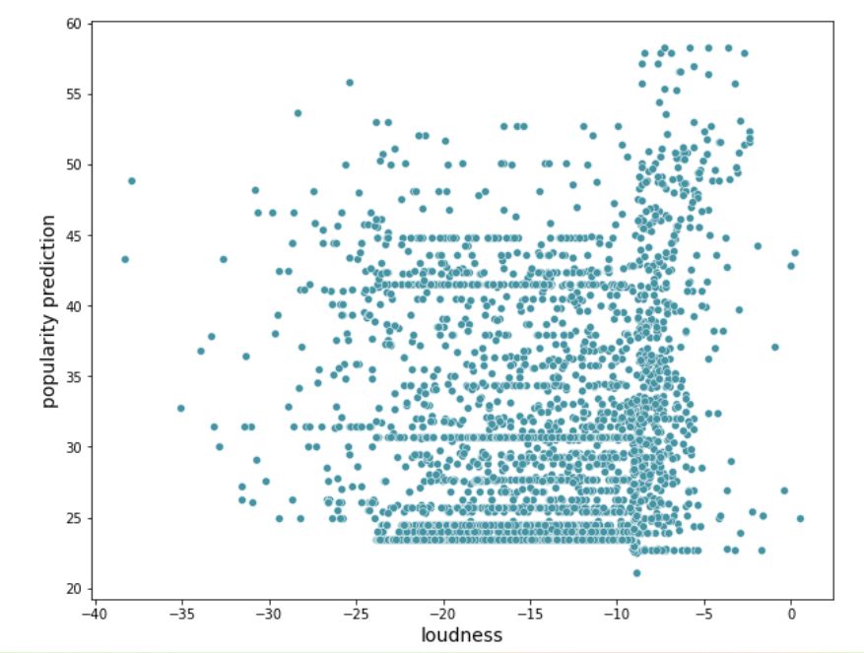
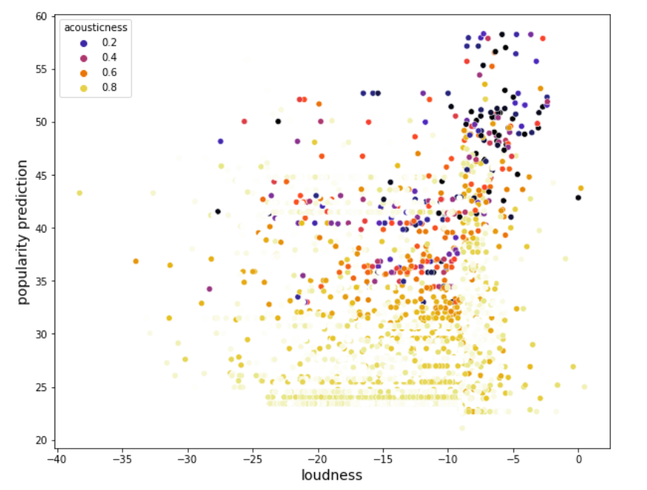
Popularity recalculation for artist with pop below 5

Slide 9
Artist Recommander with Metrics
The idea is to suggest 2 new artists based on an artist you like and its metrics
It is via KNN where the ‘artist’ is the class, and you look to the nearest ones
Metrics used = 'acousticness', 'danceability' ,'energy’, 'instrumentalness', 'liveness', 'loudness', 'speechiness', ‘tempo’, 'valence', 'mode’ [I removed ‘key’ and ‘mode’ which were numerical categories]
Loudness and tempo are transformed with MinMax so that all metrics are between 0 and 1.
Removed Popularity to really stick to music characteristics
Genre not included neither
Used sklearn.neighbors.KNeighborsClassifier method : knn.kneighbors

Slide 10
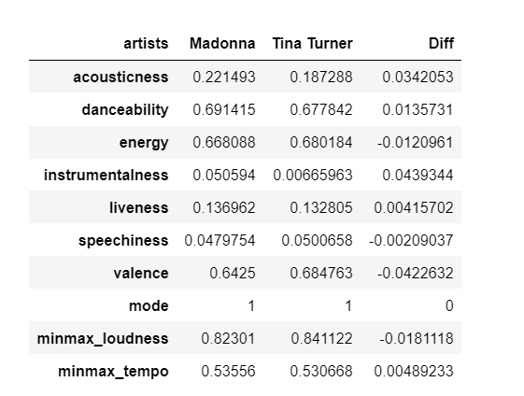
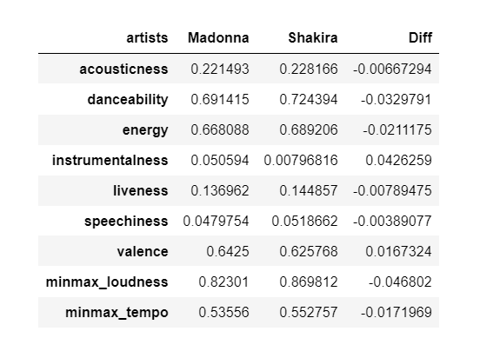
Example with Madonna
Tina Turner
Shakira

Slide 11
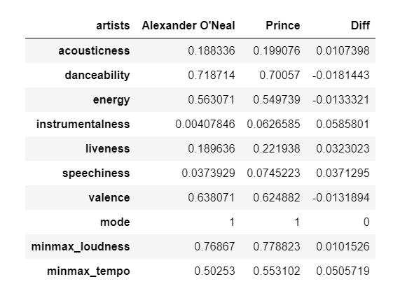
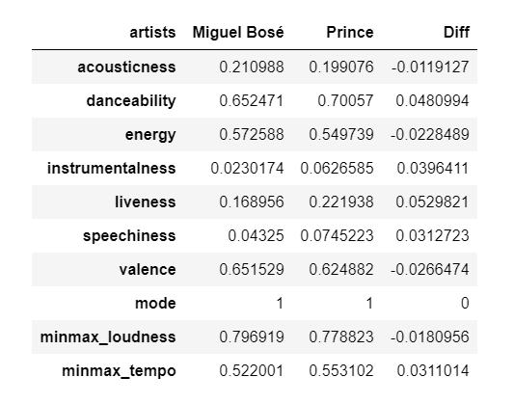
Example with Prince
Alexander O’Neal
Miguel Bosé
https://en.wikipedia.org/wiki/Alexander_O'Neal

Slide 12

Artist Recommander with Genre and Popularity
Same exercice but with genre and popularity only.
2664 different genres : from basic ‘pop’ to ‘yugoslav rock’ and ‘zimdancehall’…
Nearly 10000 artists without any genre.
Genres were given to each artist via a list. Example : ['c-pop', 'classic cantopop', 'classic mandopop’]
Thank you to MultiLabelBinarizer from Sklearn !!

Slide 13
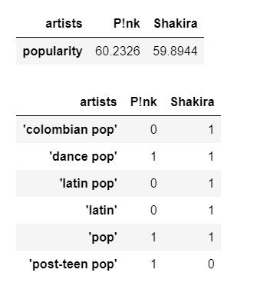
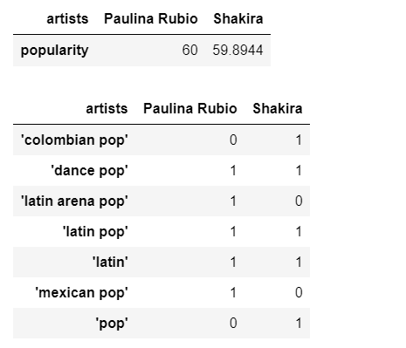
Example with Shakira
Paulina Rubio
P!nk
>> Popularity is taking all the weight

Slide 14
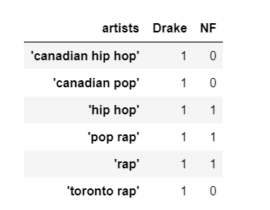
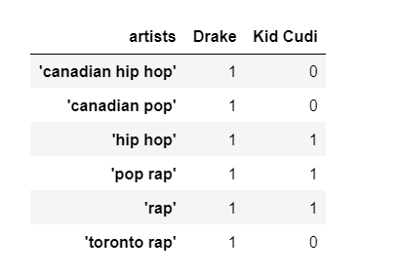
Example with Drake (without popularity)
NF
Kid Cudi
https://en.wikipedia.org/wiki/NF_(rapper)
>> Less convincing since genre labelling is too wide on Spotify

Slide 15
Unsupervised Learning : Nearest Neighbors
The user is choising the music he/she wants to listen by picking any element he/she wants from the list below
1. danceability 2. energy 3. instrumentalness 4. loudness 5. speechiness 6. valence 7. tempo
For each chosen, the user must choose whether he/she likes it high or low.
Then a style is chosen random (next release > the user will also choose the style)
The model checks if any artist matches the criteria and/or provide the most proximate (usually, genre is left out)

Slide 16
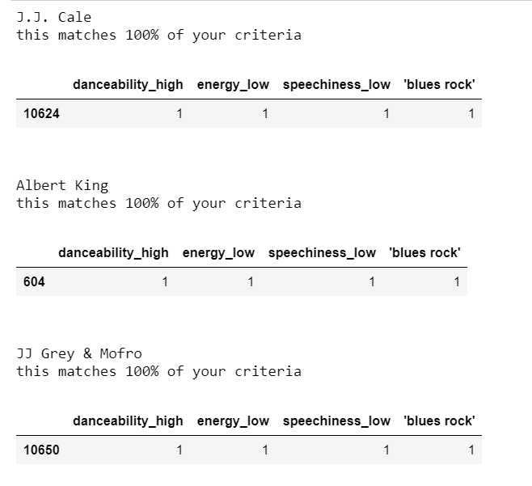

Example

Slide 17
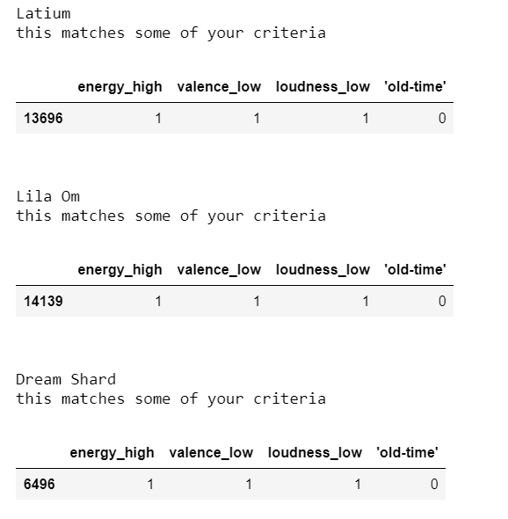


Example

Slide 18

Thank you !
All mini programs available on my github !

